Slide 1
Data Flow vs. Data Dependence
Prof. 廖世偉, liao@csie.ntu.edu.tw

Slide 2
Data Flow Analysis
What’s the difference between local analysis and data flow analysis?
Data flow analysis:
Value-based.
Lattice theory.

Slide 3
What’s the Data-flow Analysis
Local Analysis
Analyze effect of each instruction
Compose effects of instructions to derive information from beginning of basic block to each instruction
Data-flow Analysis
Analyze effect of each basic block
Compose effects of basic blocks to derive information at basic block boundaries

Slide 4
What’s the Data-flow Analysis
Data-flow analysis takes the IR as input and decides whether or not they have a certain property.
Rice’s theorem states that all interesting questions about the input/output behavior of programs are undecidable.
While it’s impossible to build an analysis that would correctly decide a property for any analyzed program, it is often possible to build analysis tools that give useful answers for most realistic programs.
Notes:
Rice’s theorem, non-trivial semantic properties are undecidable

Slide 5
What’s the Data-flow Analysis
The approximative properties of the program can help us generate efficient code:
Does the program contain dead code? If so, the code size can be reduced.
Is the value of some expression inside a loop the same in every iteration? If so, the expression can be moved outside the loop.
Does the value of variable x depend on the program input? If not, it could be pre-computed at compile time.
……

Slide 6
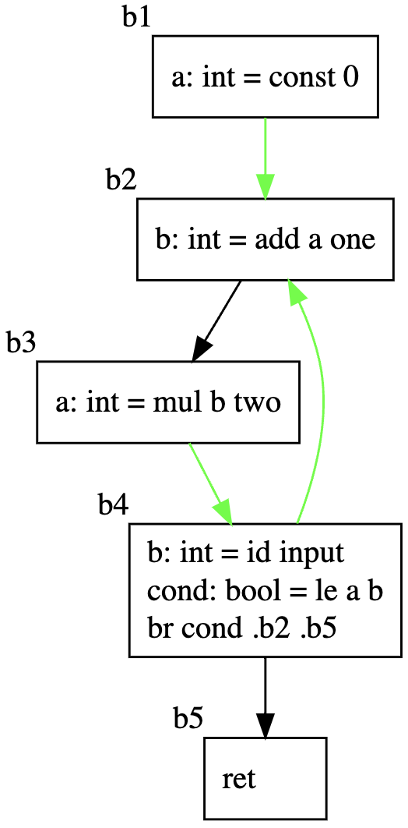
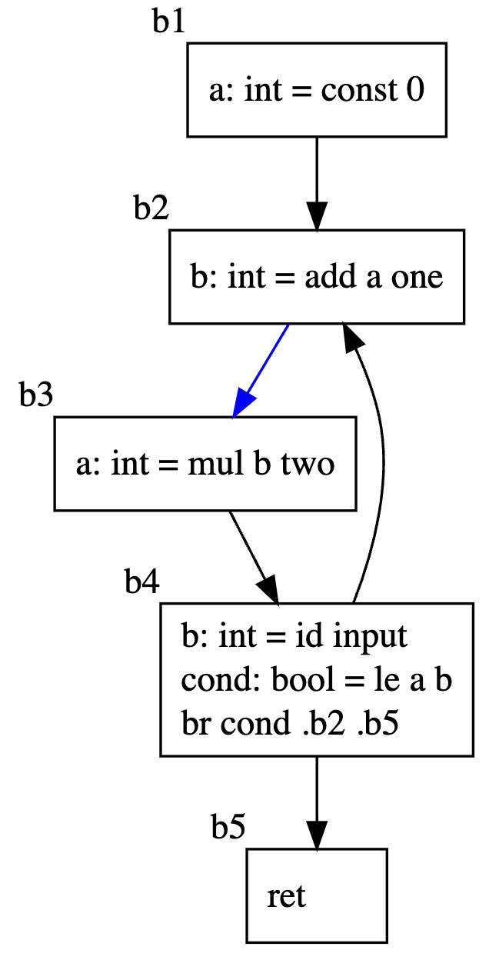
An Example of Data-flow Analysis: Liveness
Definition
A variable v is live at point p if
the value of v is used along some path in the flow graph starting at p.
Otherwise, the variable v is dead.
The green and blue arrows stand for the liveness of a and b respectively.

Slide 7
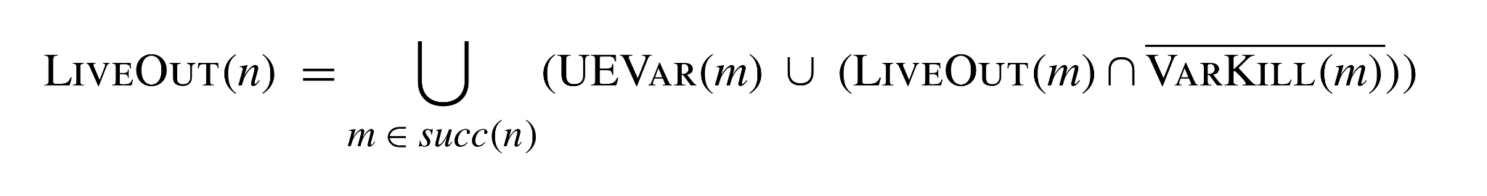
Data-flow Equation of Liveness
A variable is live on exit from a node if it is live on the entry to any successor node.
A variable is live on entry to the node if:
it is used by the node
it is live on exit from the node and the node does not redefine the value of the variable

Slide 8
Data-flow Equation of Liveness
LIVEOUT(n): The variables that are live at the end of the block n.
UEVAR(m): The variables that are used in block m before any redefinition in block m, that is, upward-exposed variables.
VARKILL(m): The variables that are defined in block m.

Slide 9
Recap: Data Flow Analysis
What’s the difference between local analysis and data flow analysis?
Data flow analysis:
Value-based.
Lattice theory.

Slide 10
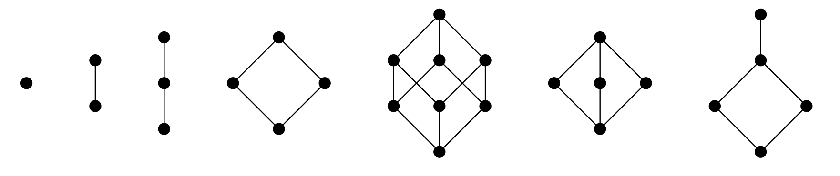
Lattice
Lattice: A partial order (S, ⊑) where x ⊔ y and x ⊓ y exist for all x, y ∈ S.
Complete lattice: A lattice where lub(X) and glb(X) exist for all X ⊆ S.
These partial orders are lattices:
Notes:
Complete lattice: A lattice where glb(X) and lub(X) exist for all X ⊆ S.
Every finite lattice is complete lattice

Slide 11
Fixed-point Theorem
Suppose the lattices have finite height and the constraint functions are monotone
Fixed-point Theorem tells us:
The equation systems over complete lattices always have solutions
Uniquely most precise solutions always exist
We can simply compute the increasing chain until the fixed point is reached

Slide 12
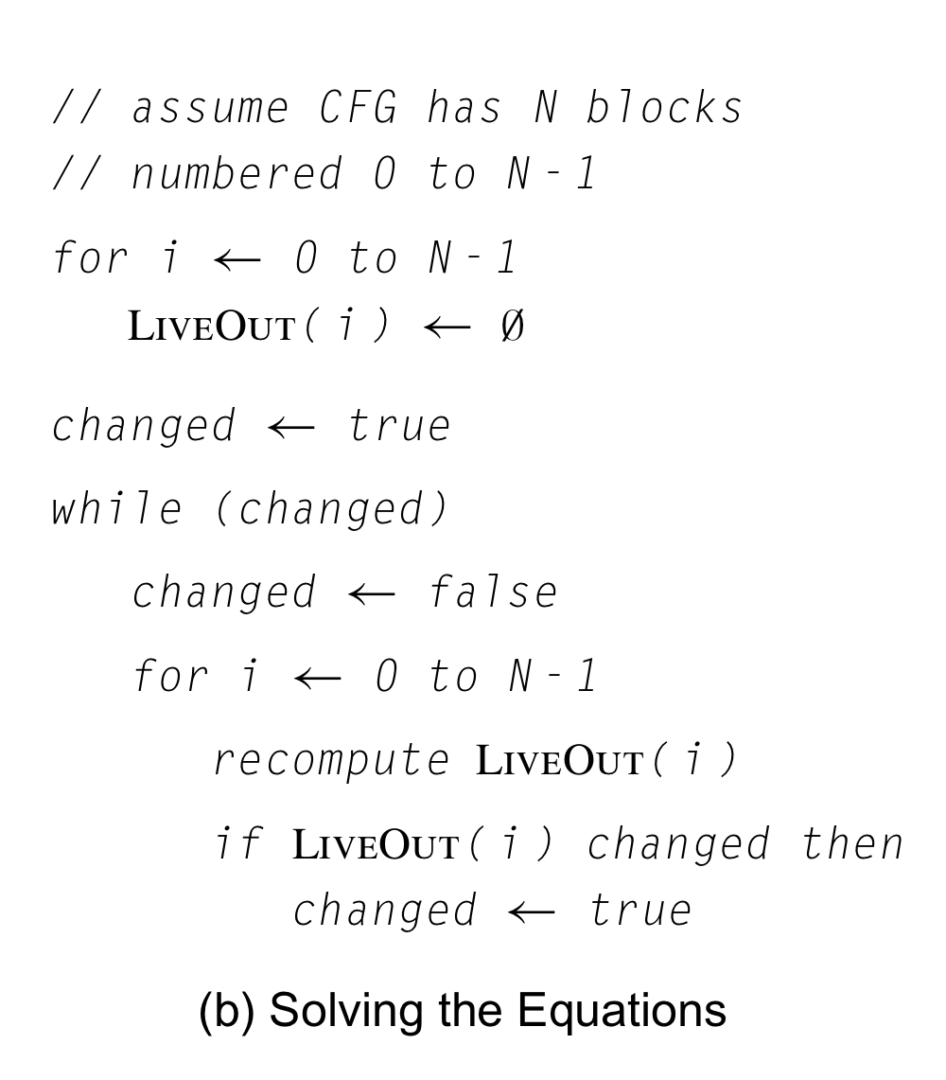
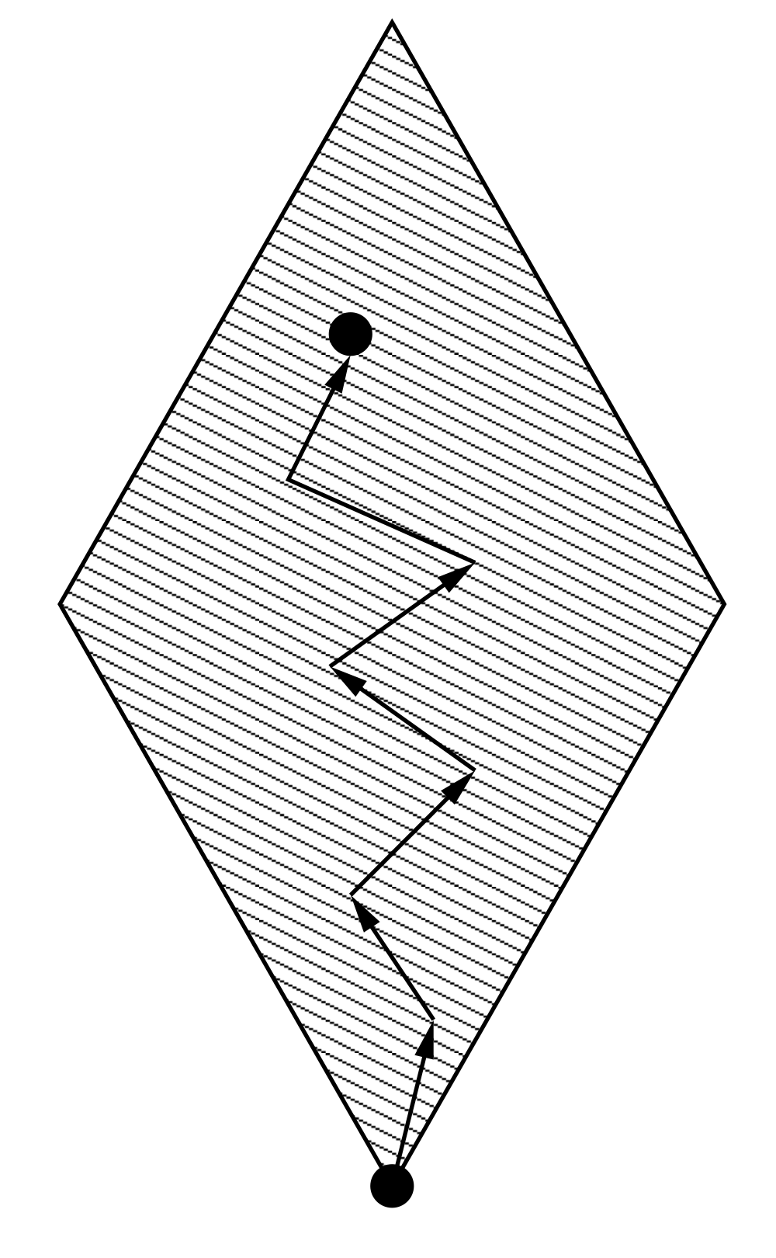
Iterative Algorithm From Fixed-point Theorem

Slide 13
Data Dependence Analysis
Location-based
Not value-based. Not data flow analysis.
Is data dependence analysis just for parallelization?
Slicing:
Data dependence
Control dependence

Slide 14
Key Theorems:
To data flow analysis, the most important theorem is fixed-point theorem.
In the mathematical areas of order and lattice theory, the Knaster–Tarski theorem, named after Bronisław Knaster (1893-1980) and Alfred Tarski (1901-1983)
To data dependence analysis, the most important theorem is Fourier-Motzkin elimination.
The algorithm is named after Joseph Fourier who proposed the method in 1826 and Theodore Motzkin who re-discovered it in 1936.
To affine partitioning, the most important theorem is Farkas’ lemma (1847-1930).
Paul Feautrier’s journey starts in 1988: Parametric integer programming

Slide 15
Salute to Paul Feautrier:
Paul Feautrier. Some Efficient Solutions to the Affine Scheduling Problem, I, One Dimensional Time. Int. J. of Parallel Programming, 21(5):313-348, October 1992.
Paul Feautrier. Some Efficient Solutions to the Affine Scheduling Problem, II, Multidimensional Time. Int. J. of Parallel Programming, 21(6):389-420, December 1992.
Paul Feautrier. Dataflow Analysis of Scalar and Array References. Int. J. of Parallel Programming, 20(1):23-53, February 1991. [POSTSCRIPT]
Pierre Jouvelot and Paul Feautrier. Parallélisation Sémantique. Informatique théorique et Applications, 24:131-159, 1990.
Paul Feautrier. Parametric Integer Programming. RAIRO Recherche Opérationnelle, 22:243-268, September 1988.

